Slide 1
Software Engineering and Professional Practice. Building Usable Software. Unit 7: Software Project Management Part 4: Executing, Monitor and control, and Closing
Anis Zarrad
a.zarrad@bham.ac.uk

Slide 2
Outlines
Project execution
Project monitor and control
Project closing

Slide 3
Project Management Process Groups
Planning
Project deliverables
Closing
Inputs
Initiation
Executing
Project Documents
Monitor and Control

Slide 4
Project Executing
Executing consists of the processes used to complete the work defined in the project management plan.
It's about accomplishing the project's objectives.
The deliverables are produced as outputs from the processes performed

Slide 5
Project Executing
It usually takes the most time and resources to perform project execution since the products of the project are produced here
Project managers must use their leadership skills to handle the many challenges that occur during project execution

Slide 6
Project Executing Activities
Project plan execution
Quality assurance
Team development
Information distribution
Source selection
Contract administration

Slide 7
Factors leading to poor Execution
Multitasking: doing several things at once
Procrastination: putting things off until the last minute.
Miscommunication with all team members and stakeholders

Slide 8
Project Management Process Groups
Planning
Project deliverables
Closing
Inputs
Initiation
Executing
Project Documents
Monitor and Control

Slide 9
Project Monitoring and Control
Controlling involves measuring progress toward project objectives.
Compare the actual with the baseline plan
Monitoring deviation from the plan, and taking corrective actions
Status and progress reports are important outputs of controlling

Slide 10
Project monitoring and control
Controlling affects all other process groups and occurs during all phases of the project life cycle
ensure there is sufficient oversight.
Help identify and mitigate any potential issues.

Slide 11
What is a baseline?
It makes the plan difficult to change
It is rather like writing the plan (schedule and cost) on the backside of Moses’ tablets
Its an anchor point for measuring performance against plan
Planned cost
Planned schedule
Planned scope

Slide 12
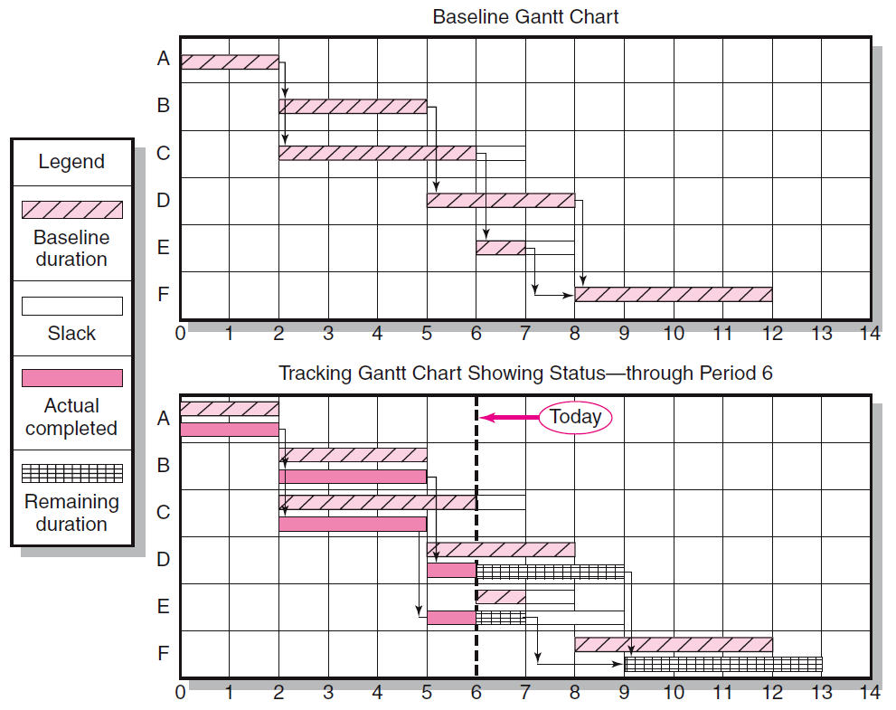
Baseline Example

Slide 13
Change request
A change request is a formal proposal for an alteration to some product or system.
Expand or reduce the scope of the project.
Requests to modify policies, procedures, plans, or processes.
Suggest how you can do this.

Slide 14
Project Monitoring and Control Something wrong
Sometimes projects delay despite everything you do to avoid it.
Questions are:
How do I realize that something is off?
What can I do to get the project back on track?
Time sheets
Slip charts
Timeline charts
Earned value analysis

Slide 15
Project Controlling Activities
Integrated change control
Scope verification
Scope change control
Schedule control
Cost control
Quality control
Performance reporting
Risk monitoring & control

Slide 16
Project Management Process Groups
Planning
Project deliverables
Closing
Inputs
Initiation
Executing
Project Documents
Monitor and Control
Notes:
.

Slide 17
Project Closing
The closing process involves gaining stakeholder and customer acceptance of the final product and bringing the project, or project phase, to an orderly end.
Even if projects are not completed, they should be closed out to learn from the past.
Project archives and lessons learned are important outputs. Most projects include a final report and presentations.

Slide 18
What can be learned from a failed project?
Strengthen Your Weaknesses
Re-Evaluate Your Team
Examine Your Strategy and Organization
Keep costs in mind
………

Slide 19
Post-Project Follow-up
Many organizations have realized that it’s important to review the results of projects a year or so after they have been completed
Many projects project potential savings, so it’s important to review the financial estimates and help learn from the past in preparing new estimates

Slide 20
Project closing Activities
Administrative closure
Post-implementation review / Lessons learnt
Document archive

Slide 21
Take-home Message
Monitoring and control processes continually track, review, adjust and report on the project's performance
lessons learned is a very important organizational process asset of a company. They are taken into account when initiating another project
Thank you

